Slide 1
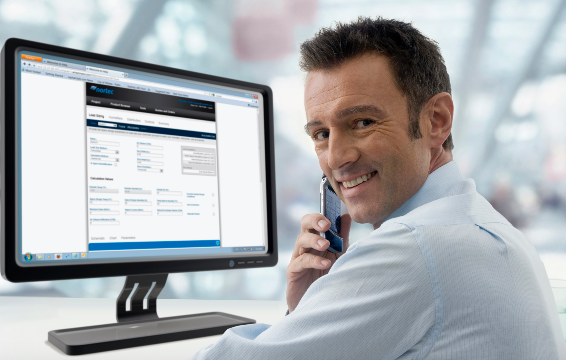
PeopleSoft ERP
FSCM 9.2 UPGRADE
Optum ERP Receivables Changes

Slide 2

Agenda
Introductions
Objectives
Schedule
Fit Gap
Business Process Deltas between 9.1 and 9.2
Online Review / Offline Review
Confirm new functionality that should be explored for system design
Workflow
If applicable – Confirm whether AWE or Virtual Approver will be used
Interfaces
Retrofit / Eliminate
Customizations
Retrofit / Eliminate
Reports
Retrofit / Eliminate
Security
Batch Schedule
Discussion

Slide 3
Introductions
Name
Functional Area
Role

Slide 4
Objectives
An overview of New or updated features in PeopleSoft Receivables 9.2 release
Identify Gaps
Confirm Inventory of Interfaces, Customizations and Reports
Determine the Impacts on current business processes
Facilitate the next stage – Upgrade A&D Project

Slide 5
Schedule
Date | Time | Topic
10/07/2016 | 9 AM – 11 AM (CST) | Business Modeling Session 1: Receivables
10/11/2016 | 11 AM – 1 PM (CST) | Business Modeling Session 2: Receivables

Slide 6

PeopleSoft 9.2 Global Enhancements

Slide 7
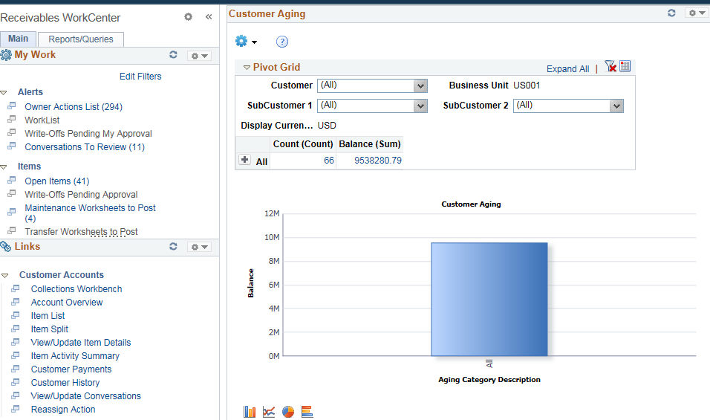
Pivot Grids
Pivots grids are based on PS Queries and can display the results in a grid format, a chart format, or both. Use the Pivot Grid Wizard to design how the page should appear.
Pivot grids can be added as pagelets (on a user’s Home page) and to the Queries tab in a WorkCenter.

Slide 8
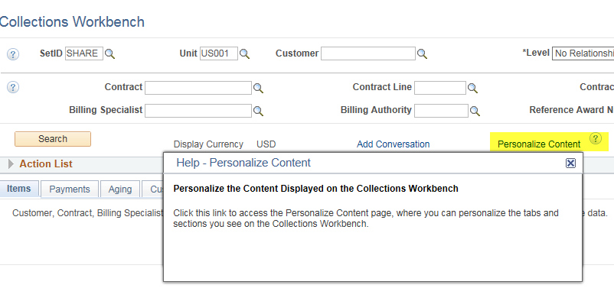
Embedded Help
Click the Embedded Help icon to open a secondary window with information about the page or section
Explains How to perform a specific task
Message appears in the Modal window which can be moved around the page

Slide 9
Alignment, Order and Positioning
Alignment
In PeopleSoft 9.1, all of the search and transaction fields were aligned to the left side of the page
In PeopleSoft 9.2, all of the search and transaction field labels will be right aligned to the fields
Order and Positioning
Order and position of fields on the page may have changed
Function is not impacted or changes as a result

Slide 10
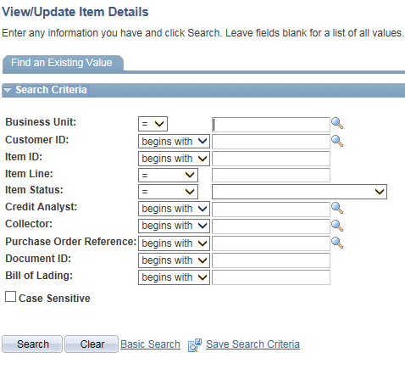
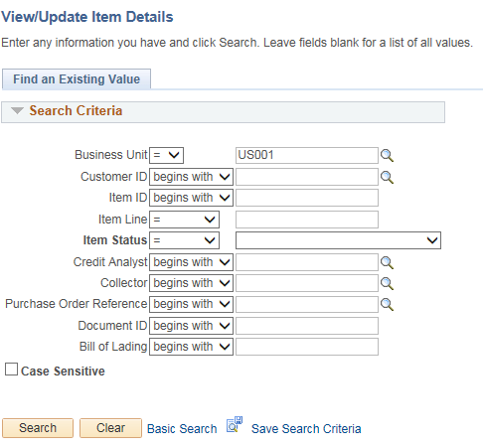
Alignment, Order and Positioning
PeopleSoft 9.1 PeopleSoft 9.2

Slide 11
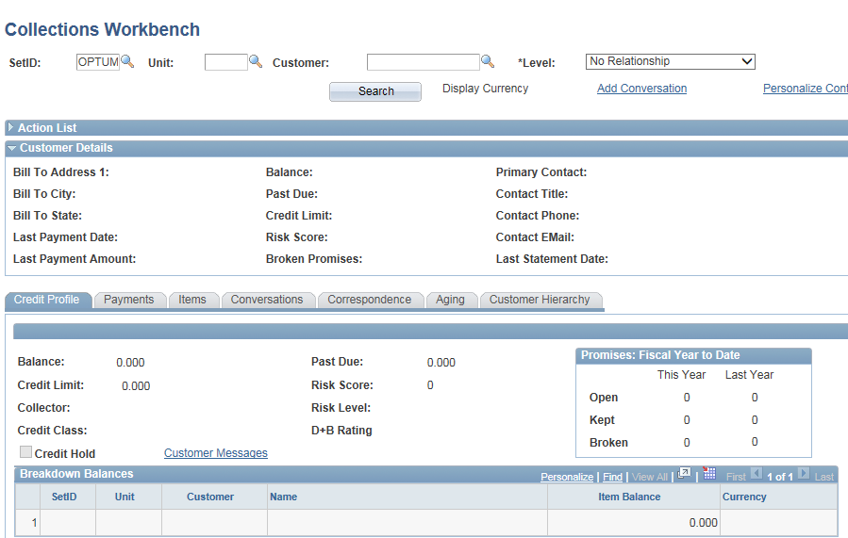
Alignment, Order and Positioning
PeopleSoft 9.1

Slide 12
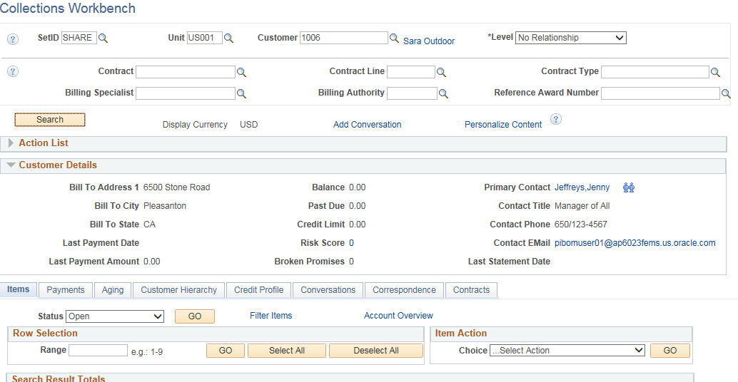
Alignment, Order and Positioning
PeopleSoft 9.2

Slide 13
PeopleSoft 9.2 Receivables Features

Slide 14
Receivables 9.2 Highlights
Customer Hierarchy
Receivables Direct Journals to Project Costing Integration
Worksheet enhancements
Item Level Attachments
Maintenance Worksheet updates (new sort capability; Additional search criteria.
New Reference Qualifier Code
Item Splitting for Exception Items
Payments Page Enhancement
Hosted Credit Card Storage and Payment
Partial Payment Unpost
Receivables Work Center

Slide 15
Receivables 9.2 Highlights - Continued
Receivables Dashboard Pagelets for Customer Portfolio Analysis
Collections Workbench Enhancements
Conditions Monitor Enhancements
Enhanced Conversation Features
Aging and Dunning Enhancements

Slide 16
Business Processes – Deltas 9.1 vs 9.2
Customer Hierarchy:
Now displays customer relationships and data in an interactive chart format
that enables users to:
Visualize different types of customer hierarchies, including corporate, remit to, and correspondence hierarchies.
View rolled-up data for the selected customer, or for the customer and its’ children.
Drill to customer details.
Take actions on the customer, such as putting the customer on hold.
Save search criteria.
Customize display templates. Security setup at the user, role, or system level restricts customer information, template modifications, and actions to authorized users.

Slide 17
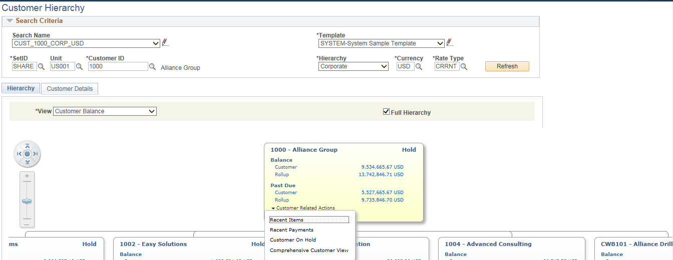
Business Processes – Deltas 9.1 vs 9.2
Customer Hierarchy (Continued):

Slide 18
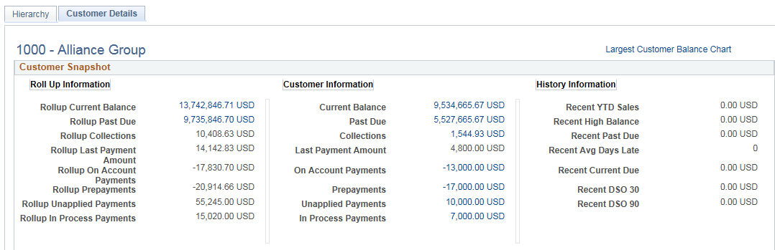
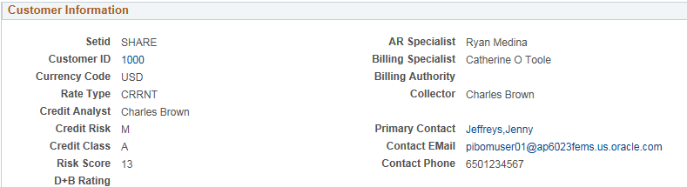
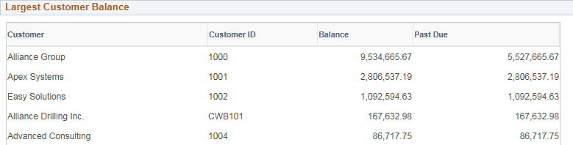
Business Processes – Deltas 9.1 vs 9.2
Customer Hierarchy (Continued):

Slide 19
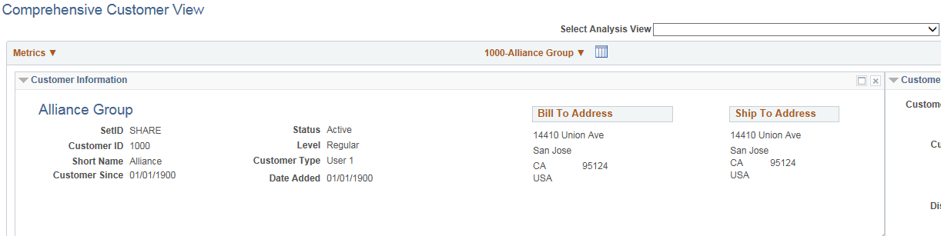
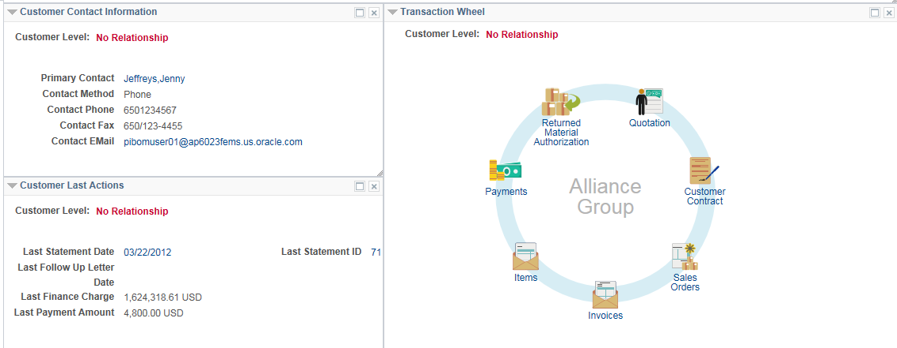
Business Processes – Deltas 9.1 vs 9.2
Customer Hierarchy (Continued):

Slide 20
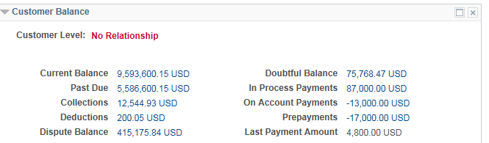
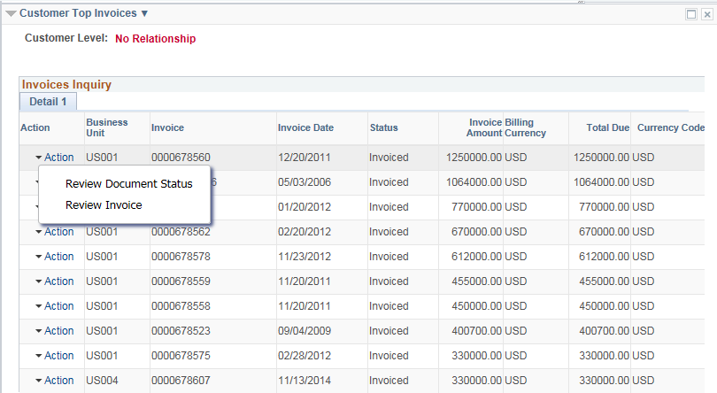
Business Processes – Deltas 9.1 vs 9.2
Customer Hierarchy (Continued):

Slide 21
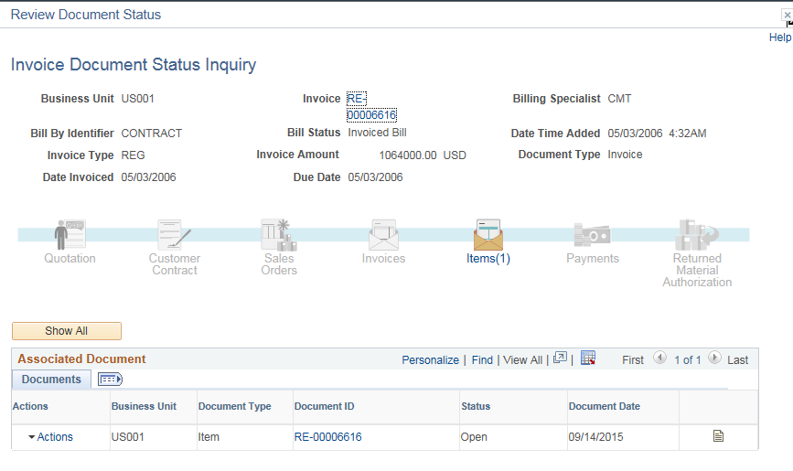
Business Processes – Deltas 9.1 vs 9.2
Customer Hierarchy (Continued):
When a user clicks on the Review Document Status Action from the Action drop-down a new page
appears providing a billing status amongst other information and links to documents.

Slide 22
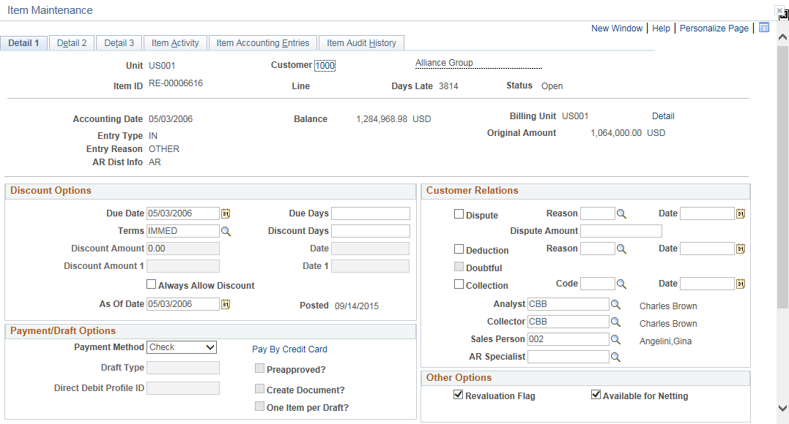
Business Processes – Deltas 9.1 vs 9.2
Customer Hierarchy (Continued):
When a user clicks on the Document ID link the user is brought to the Item Maintenance pages.

Slide 23
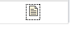
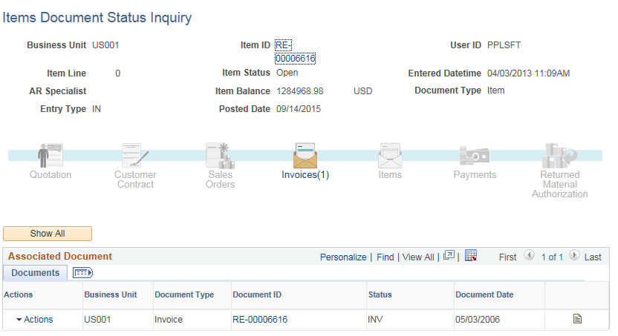
Business Processes – Deltas 9.1 vs 9.2
Customer Hierarchy (Continued):
When a user clicks on the Document Status Icon the user is brought to the Items Document Status Inquiry page.

Slide 24
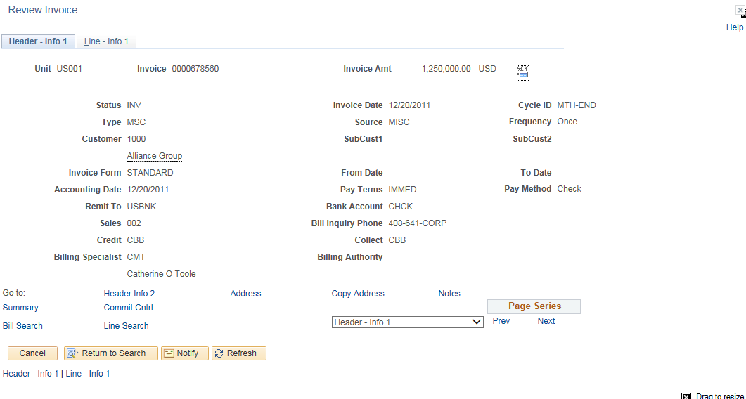
Business Processes – Deltas 9.1 vs 9.2
Customer Hierarchy (Continued):
When a user clicks on the Review Invoice Action from the Action drop-down the user is taken
to the Billing Header and Line Information pages in the PeopleSoft Billing module.

Slide 25
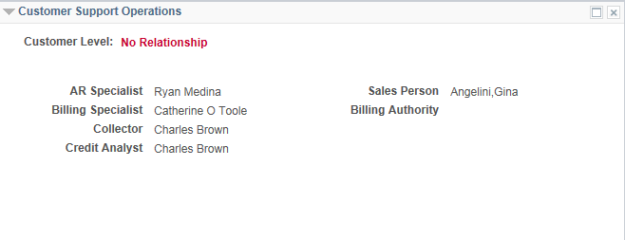
Business Processes – Deltas 9.1 vs 9.2
Customer Hierarchy (Continued):

Slide 26
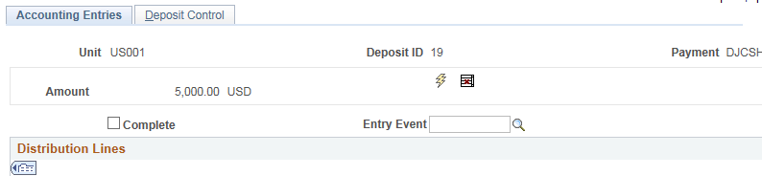
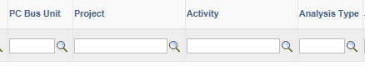
Business Processes – Deltas 9.1 vs 9.2
AR Direct Journal Integration with Projects:
PeopleSoft AR 9.2 extends the AR to PC integration by interfacing AR direct journals to Project Costing. The interface process was modified to pick up direct journals from Receivables. Users are able to specify an analysis type while entering the direct journal which makes AR direct journal integration to PC consistent with other subsystems.

Slide 27
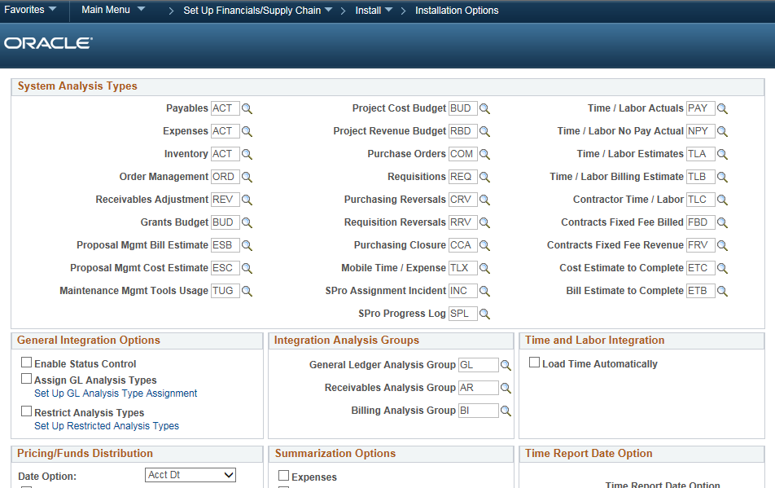
Business Processes – Deltas 9.1 vs 9.2
AR Direct Journal Integration with Projects - Continued:

Slide 28
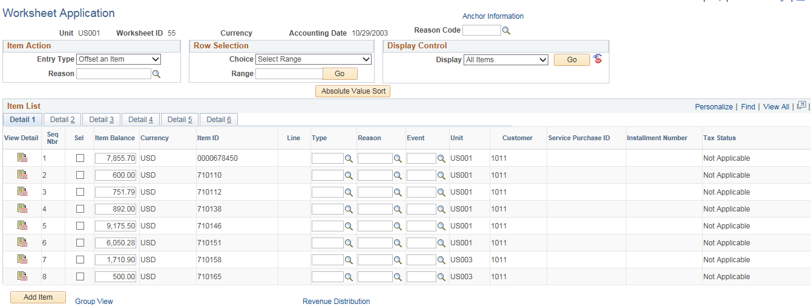
Business Processes – Deltas 9.1 vs 9.2
Worksheet Enhancements - Item-Level Attachments:
The attachments capability has been extended for online pending items. Users are able to view item-level attachments through the payment, maintenance, and credit card worksheets. Users are also able to view billing invoice attachments from Receivables for open items that were created through Billing and to access them in the various worksheets.

Slide 29
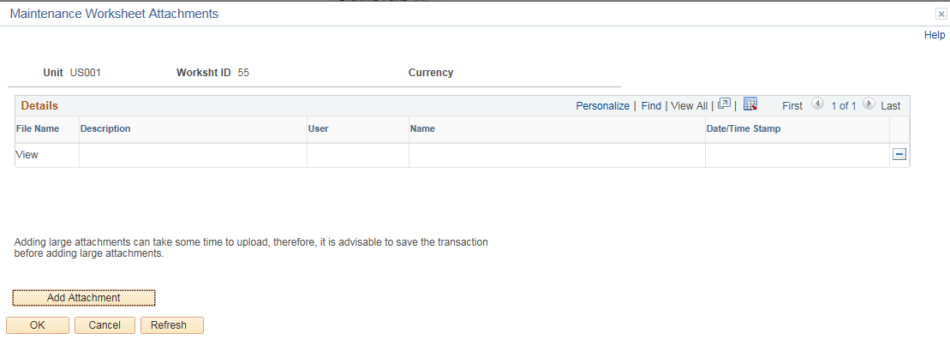
Business Processes – Deltas 9.1 vs 9.2
Worksheet Enhancements - Item-Level Attachments – Continued:

Slide 30
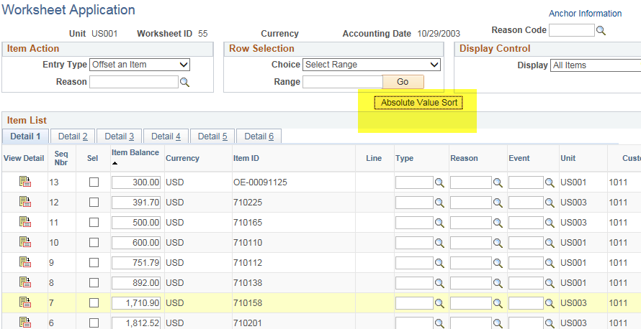
Business Processes – Deltas 9.1 vs 9.2
Worksheet Enhancements - Item Maintenance Worksheet:
Enhancements include:
Ability to sort the maintenance worksheet by absolute value of the item balance column so users can quickly find related credit and debit items.

Slide 31
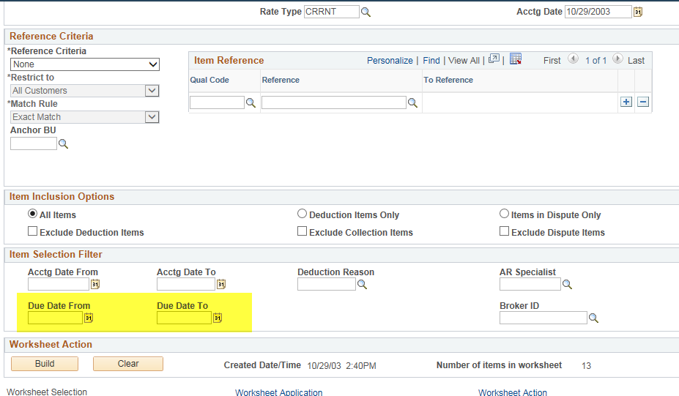
Business Processes – Deltas 9.1 vs 9.2
Worksheet Enhancements - Item Maintenance Worksheet - Continued:
Provides additional search criteria. Use due date to/from to search for items.

Slide 32
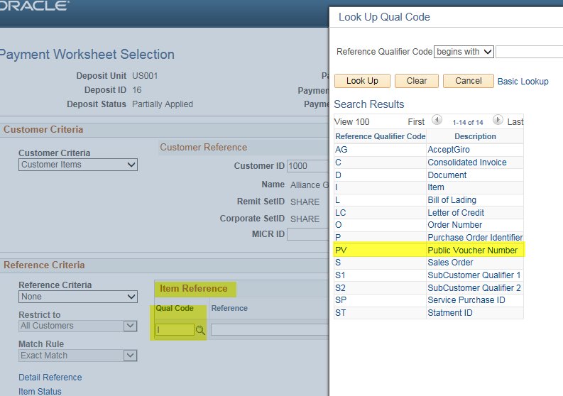
Business Processes – Deltas 9.1 vs 9.2
Worksheet Enhancements - New Reference Qualifier Code:
PeopleSoft has added a new Item Reference Qualifier Code (PV) to reference Public Voucher Numbers on the Worksheet pages. The Public Voucher Number is used to group multiple bills on a single invoice. This number will either be generated in PeopleSoft Billing via the Billing Interface or passed in from Contracts and defined as a Bill By Field.

Slide 33
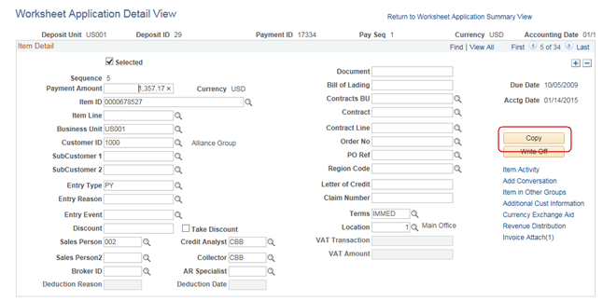
Business Processes – Deltas 9.1 vs 9.2
Worksheet Enhancements – Enhanced Copy Functionality:
A new copy function allows an item to be copied independent of whether the item has been selected on the payment worksheet. This enables the AR specialist to create adjustments to lines that have already been selected for payment.

Slide 34
Business Processes – Deltas 9.1 vs 9.2
Item Splitting for Exception Items:
Using the new Item Split page users can split an exception (deduction or disputed) item into multiple lines.
This function is useful when a customer is disputing only part of an invoice, or when a customer has taken a deduction for multiple reasons and you want to track the reasons separately.
When you split an item, the system creates a new item using either the Create a Debit (MT-04) or Create a Credit (MT-05) automatic entry type for the split item in the Pending Item table. The new item uses the original item ID and the next available line number. The system creates a maintenance group, containing the original item and the new split item, that is set to post.

Slide 35
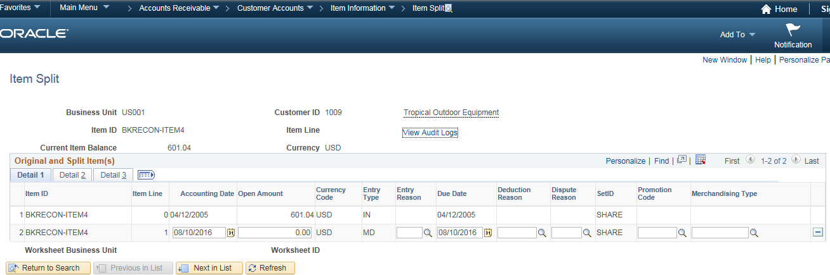
Business Processes – Deltas 9.1 vs 9.2
Item Splitting for Exception Items - Continued:

Slide 36
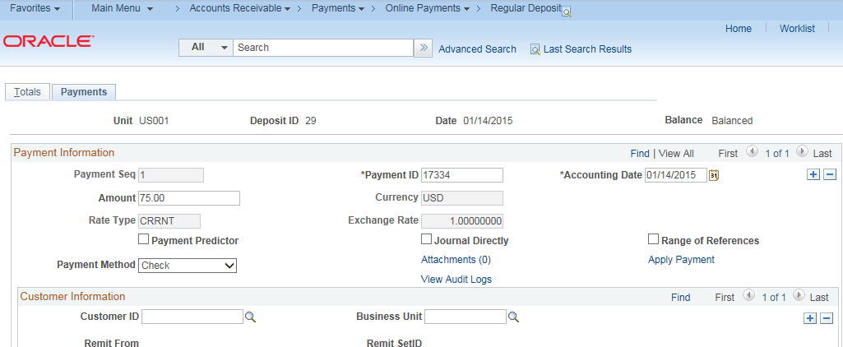
Business Processes – Deltas 9.1 vs 9.2
Payment Page Enhancement –
A link has been added to apply the entered payment directly from the Payments page, without having to navigate back to the menu. The new link takes you directly to the Payment Worksheet page or the Direct Journal Accounting Entries page, depending on the type of payment.

Slide 37
Business Processes – Deltas 9.1 vs 9.2
Third-Party Hosted Credit Card Storage and Payment:
PeopleSoft 9.2 Receivables provides the ability to employ Third-Party Hosted Storage and Payment to remove the responsibility from the organization for credit card data security.
PeopleSoft FSCM provides a framework in the Order to Cash modules to facilitate the collection and processing of payment information by third-party credit card hosts.
Currently PS ERP does not store any credit card information for Optum’s customers. A third party credit card processor, Trust Commerce, is used for credit card processing. Credit card payments are then applied manually in PS AR.

Slide 38
Business Processes – Deltas 9.1 vs 9.2
Third-Party Hosted Credit Card Storage and Payment - Continued:
Before you begin using the hosted credit card model, you must prepare your system:
Setup a third-party payment processor. Multiple processors can now be set up and assigned to a specific credit card type.
Create a default credit card group for a specific credit card type at the system level, and optionally at the business-unit level.
Before you begin accepting credit card charges from customers, you must set up this information:
The types of credit cards (Visa, Master Card, and so on) that you will accept for payment. Use the Credit Card Type page (Enterprise Components, Component Configurations, Credit Card Interface, Credit Card Type).
Credit card options (Set Up Financials/Supply Chain, Common Definitions, Credit Cards, Credit Card Options) and in PeopleSoft Order Management, if applicable.
An integration with a third party credit card processor

Slide 39
Business Processes – Deltas 9.1 vs 9.2
Third-Party Hosted Credit Card Storage and Payment - Continued:
Credit card worksheets enable you to select existing PeopleSoft Receivables items and pay them by credit card. Credit card worksheets are created during credit card batch processing, when items are paid by credit card from inquiries and when they are built directly through the credit card worksheet pages. Credit card worksheets populate the same tables as payment worksheets.
The credit card worksheet components behave differently depending on whether or not the credit card payment has been authorized and settled. Before settlement, use the credit card worksheet to select items that make up the amount to be authorized and settled. After the credit card payment has been settled, unposting the payment enables you to use the credit card worksheet to apply the payment to items in the same way you would use a payment worksheet.

Slide 40
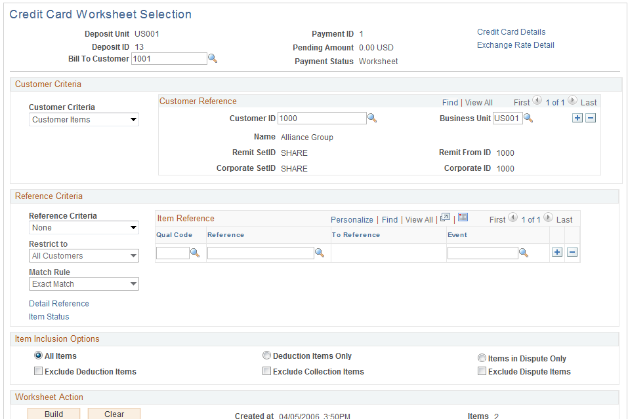
Business Processes – Deltas 9.1 vs 9.2
Third-Party Hosted Credit Card Storage and Payment - Continued:
Image: Credit Card Worksheet Selection page

Slide 41
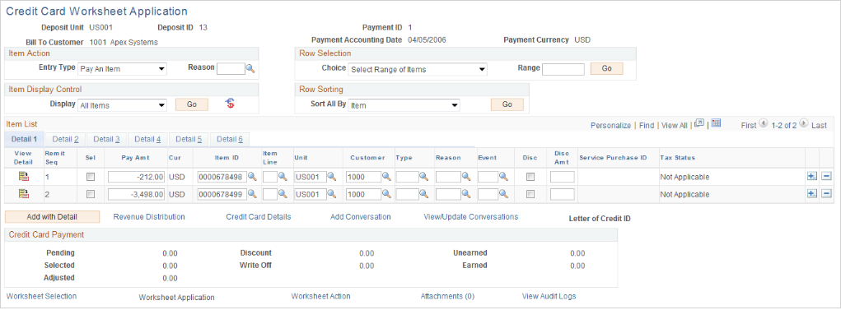
Business Processes – Deltas 9.1 vs 9.2
Third-Party Hosted Credit Card Storage and Payment - Continued:
Image: Credit Card Worksheet Application page

Slide 42
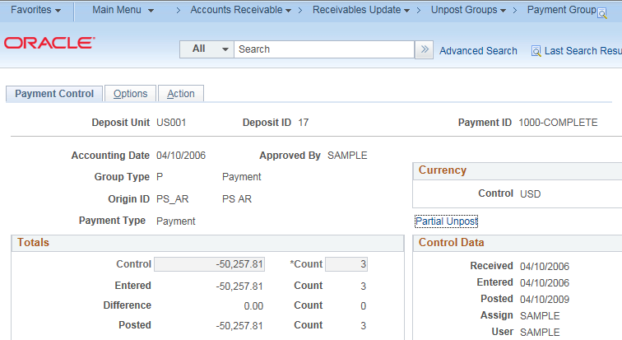
Business Processes – Deltas 9.1 vs 9.2
Partial Payments Unpost - The newly designed Payment Unpost process allows users to partially unpost payments.
The standard unpost group will be created, unposting the entire payment group.
The system presents the user with a Partial Unpost Worksheet with all the original payment applications from the payment group.
The user can deselect one or more items from this payment application page, effectively unposting those items.
The user can add new items and perform other transactions to rebalance the payment application.

Slide 43
Business Processes – Deltas 9.1 vs 9.2
Receivables WorkCenter:
A centralized workspace for Receivables users that manages cash application, payment receipts and other accounts receivable tasks.
Easy and Quick delegation of tasks
Drilldown to transaction detail
Ability to run processes on multiple transactions. For example, link to Accounting Entries to GL page allows users to select multiple transactions and kick off the Journal Generator process.
View query results and reports
Eliminates tedious navigation
Personalize work tasks by adding/removing delivered alerts, links, reports
Personalize reports by adding your run control options for reports (Gear icon). Run control parameters are userid specific.
Link to external sites
Role based

Slide 44
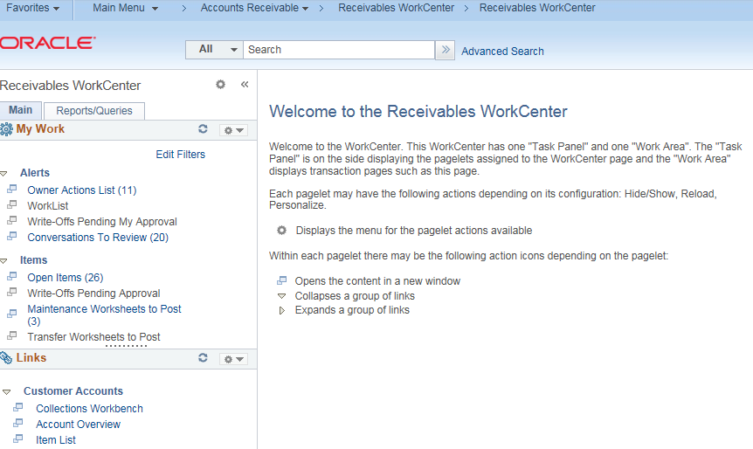
Business Processes – Deltas 9.1 vs 9.2
Receivables WorkCenter – Continued:

Slide 45
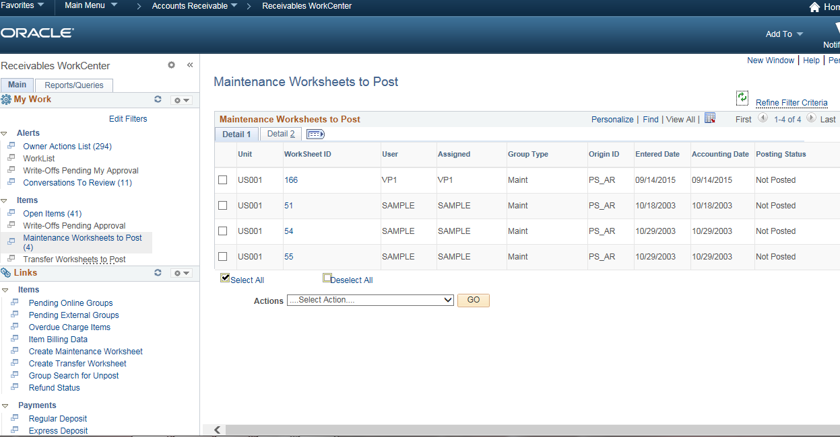
Business Processes – Deltas 9.1 vs 9.2
Receivables WorkCenter – Continued:

Slide 46
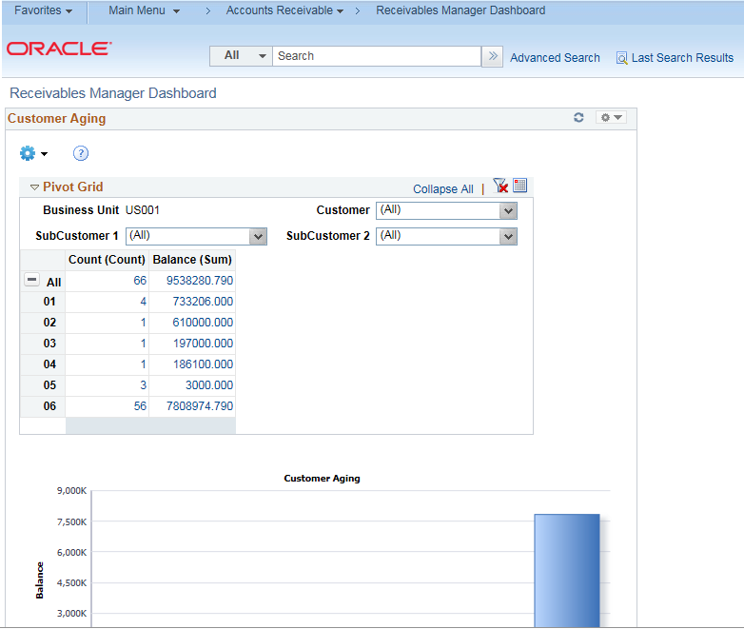
Business Processes – Deltas 9.1 vs 9.2
Receivables Manager Dashboard – Provides customer portfolio analysis. The new pagelets enable AR managers to monitor key information such as Receivables balances by customer, customer aging, items by status, and payments by status through graphs and charts that present data using PeopleTools pivot grid functionality.

Slide 47
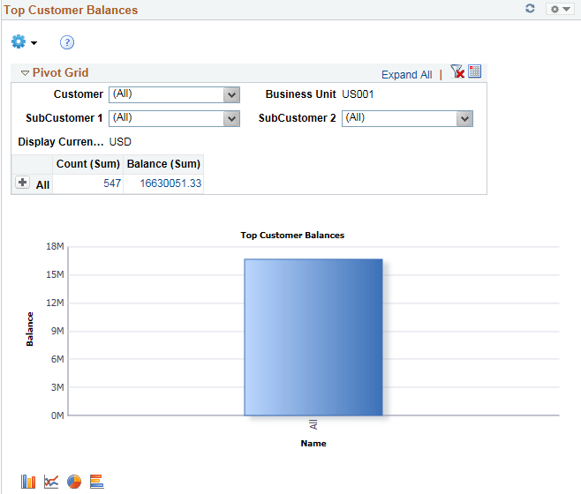
Business Processes – Deltas 9.1 vs 9.2
Receivables Manager Dashboard – Continued:

Slide 48
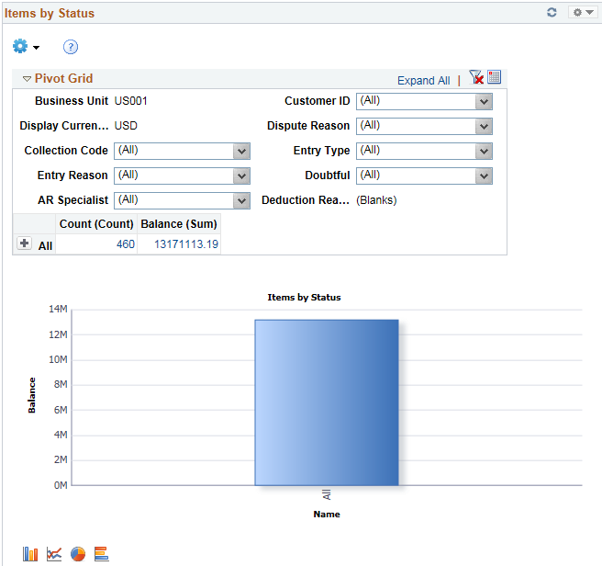
Business Processes – Deltas 9.1 vs 9.2
Receivables Manager Dashboard – Continued:

Slide 49
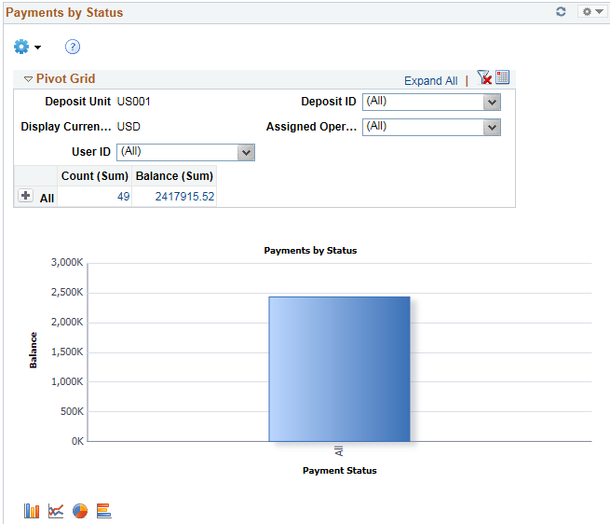
Business Processes – Deltas 9.1 vs 9.2
Receivables Manager Dashboard – Continued:

Slide 50
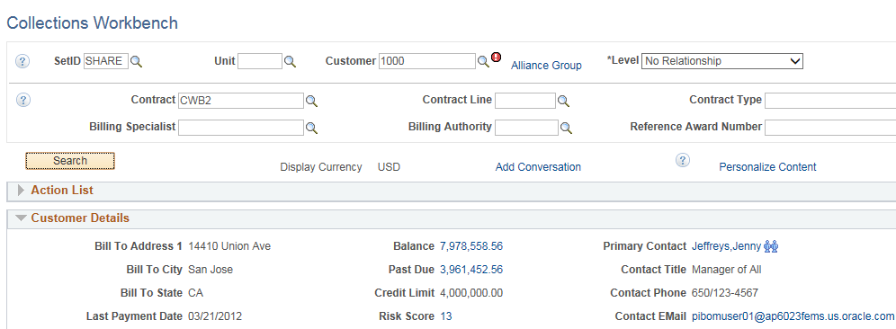
Business Processes – Deltas 9.1 vs 9.2
Collections Workbench
PeopleSoft Receivables 9.2 extends the support for contracts and projects by providing additional search capabilities and showing customer balances by contracts and projects.
Users can search for Receivables open item balances by contract, billing specialist, and billing authority and view balances by contract and contract line. The Collections Workbench also shows all projects tied to an open item balance within a contract or contract line.

Slide 51
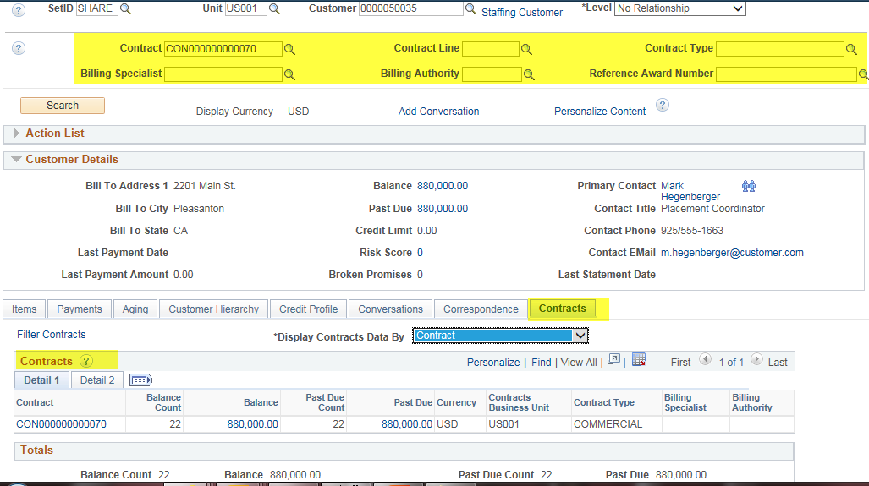
Business Processes – Deltas 9.1 vs 9.2
Collections Workbench – continued:

Slide 52
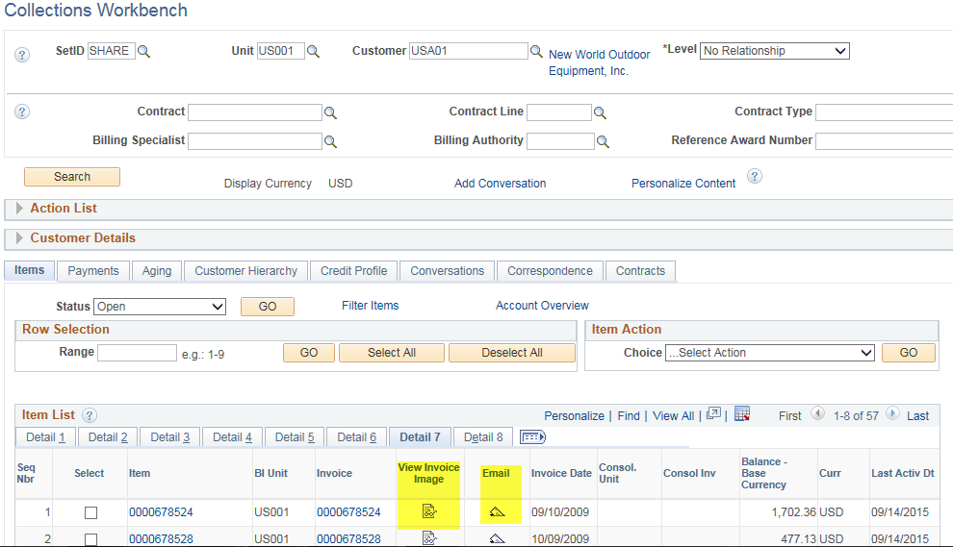
Business Processes – Deltas 9.1 vs 9.2
Collections Workbench – continued:
Invoice images are now available directly in PS Receivables 9.2 as shown below.

Slide 53
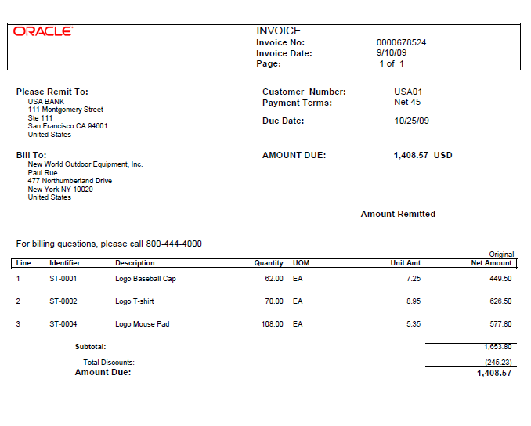
Business Processes – Deltas 9.1 vs 9.2
Collections Workbench – continued:

Slide 54
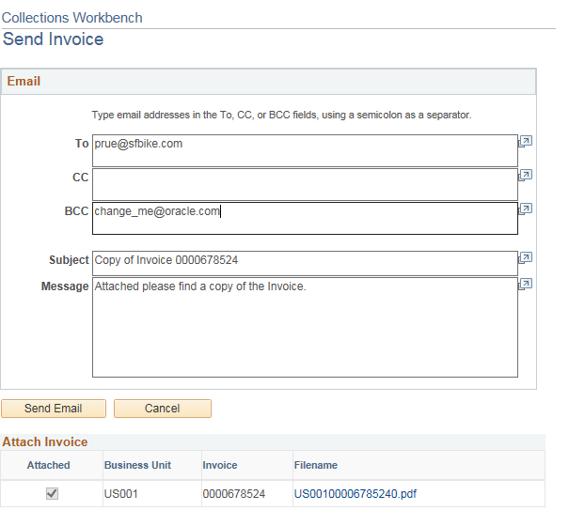
Business Processes – Deltas 9.1 vs 9.2
Collections Workbench – continued:
Duplicate Invoice images can also be e-mailed to customers from within the Workbench.

Slide 55
Business Processes – Deltas 9.1 vs 9.2
Condition Monitor Enhancement:
Condition Monitor will now generate a welcome call action for collectors to follow up with new and recently active customers, and to create an action list for the assessment rule user from an item rather than always from the customer.
The functionality was made consistent between system-completed actions and user-completed actions; the action will not be generated again if it has been marked as complete by a user

Slide 56
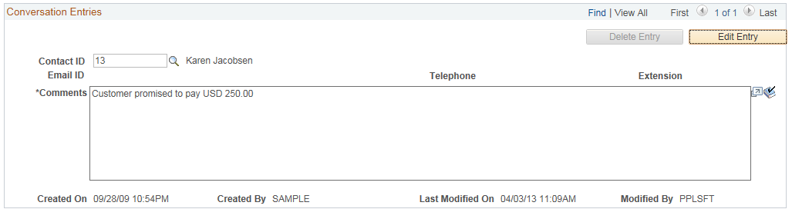
Business Processes – Deltas 9.1 vs 9.2
Customer Conversation enhancements
Delete Conversation entries
Can only delete your own conversations
Check spelling on text you have entered in the Conversations entry box

Slide 57
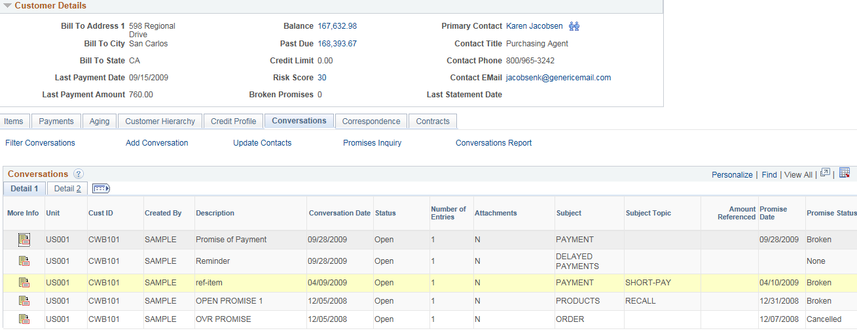
Business Processes – Deltas 9.1 vs 9.2
Customer Conversation enhancements – Continued:
Provides a new summary page of all conversations for a particular item across business units. When multiple conversations exist for an item, you can easily view a list of conversations as well as the conversation entries without opening individual conversation pages.

Slide 58
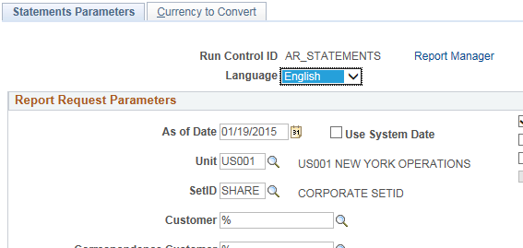
Business Processes – Deltas 9.0 vs 9.2
Report enhancements
In 9.2, dunning reports and customer statements can be set up to run by contract number.
A new system data parameter that can be used to generate aging, customer statements, and overdue charges enables users to set recurrence for processes and have them run for the current date without any user intervention.

Slide 59
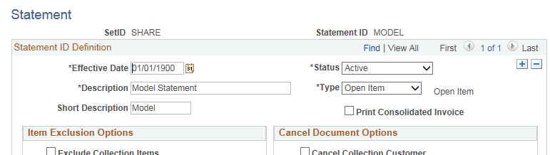
Business Processes – Deltas 9.1 vs 9.2
Report enhancements (continued)
In 9.2, PeopleSoft offers an option to print consolidated invoices on customer statement reports. Displays individual invoices in addition to the consolidated invoice ID with rollup balances.

Slide 60


Business Processes – Deltas 9.1 vs 9.2
Report enhancements (continued)
In 9.2, you can set an aging ID default at the customer level in addition to the business unit default. The aging reports also offer new options to exclude customers with a different Aging ID than the one entered on the run control page, as well as an option to print subtotals by sub-customer.

Slide 61

Business Processes – Deltas 9.1 vs 9.2
Report enhancements (continued)
Aging reports have also been enhanced to show aging for all items by department, summarized by contract number and grouped by customer ID and business unit.

Slide 62
Appendix
Approval Framework for Write-Offs
The Approval Framework in PeopleSoft Receivables 9.2 includes the ability to add an ad hoc approver during the workflow cycle, and add comments and attachments to a transaction during the workflow cycle.
Designed to require approval for write-offs entered on the payment, credit card, and maintenance worksheets.
The approval does not pick up write-off transactions from processes such as the Payment Predictor process and the Automatic Maintenance process.
PeopleSoft Approval Framework feature is a type of workflow involving several steps and people working together.
PeopleSoft can automatically trigger notifications to inform the approver in the process of work awaiting him or her. The approval process could include one or more approval steps with different approvers.
The framework is configurable and functional users can design and maintain these processes without the need for technical developers creating workflow rules.
Write-off approval requests are routed to the approvers by worklist, email, or push notification.

Slide 63
Appendix
Push Notifications:
Push Notification is an event framework that enables PeopleSoft server run time to push data directly to PeopleSoft browsers.
The feature allows defining individual events or group-related events as collections and provides an API to dispatch events to browser clients.
Notification Window uses the push mechanism provided by Push Notification and collates various notifications generated by the system to the window.
It categorizes notifications into actions and alerts and allows actions to be performed on the notification items.
Approval Workflow Engine (AWE) is one of the functional areas that will have their notifications published to the Notification Window.

Slide 64
Customizations
Customizations | Description | Carry forward
Auto Maintenance | Update made to delivered AR_AUTOMNT process which only matches on one field (Inv. ID) to include Invoice ID, Customer ID and Open Balance fields in order to match debits and credits on all 3 fields. (Note: This functionality is not currently used.) | Retrofit/Eliminate?
Collection Status | Custom program created that pulls all the open conversations to identify if the invoices associated with the conversations/customers are fully paid and changes the status of the conversation to ‘Closed’ This process also updates the collection status of a customer by identifying the keywords associated with the open conversations. This collection status will be used by the collectors to review the current status of an account. (Note: Business is currently not using the Conversations and Collections functionality in PS AR.) | Eliminate
Condition Monitor | Modified program to generate actions (dunning letters, communications, etc.) based on the prior action completion date and the specified number of days passed after the prior action completion date irrespective of the dollar amount O/S. Collection strategy is classified on the 3 customer groups: Key, Strategic and Core. (Note: Business is currently not using the Condition Monitor/Collections functionality in PS AR.) | Eliminate

Slide 65
Customizations
Customizations | Description | Carry forward
Conversations | View/Update Conversation search page enhanced to display the Comments field in the search results grid. Item, Item Balance, Currency and Conversation Qualifier fields were added to the Conversations/Search by Keyword component. Review Date added to the Conversations/Follow-Up Action Needed search page. | Eliminate
Correspondence - Statements | Modified customer statement process as follows: Updated delivered statement template per business specs. E-mail statements to customer as attachments if customer contact’s delivery method set to “E-Mail”. Capture & display the delivery method (E-mail/Print) under the statement history on the Correspondence tab in Collections Workbench. Send carbon-copies of e-mailed statements to a generic business e-mail address for collector review. New page created to store the Return Address on the Statement’s Print Envelope by AR processing unit. Removal of the Attn: Accounts Payable wording from the Print Envelope. Display ACH Instructions on Statements. | Retrofit
Correspondence – Dunning Letters | Modified customer dunning letters as follows: Created 2 new addl. templates and updated delivered templates per format provided by business. E-mail dunning letters to customers as attachments. E-mail dunning letters to correspondence contact’s e-mail address. Additional code for error handling if no address found. Capture & display the delivery method under the dunning history on the Correspondence tab in Collections Workbench. Send carbon-copies of e-mailed dunning letters to a generic business e-mail address for collector review. | Eliminate

Slide 66
Customizations
Customizations | Description | Carry forward
Item | Provided ability to enter notes on an AR item after it’s posted and set bad debt indicator at an item level (View/Update Item Detail pages). Enter notes on the payments tab of a deposit. | Retrofit
Lockbox | New job created for modifications to the AR25001 SQR and AE AR_PAYLOAD to handle additional payment types for lockbox processing (VSA/MST/AMX/DSC/WIR/ACH). Delivered payment method will display “CHK” but actual values will be stored in custom field Payment Type. | Retrofit
Short Payment Notifications | Custom process designed to identify short payments after payment processing is complete and notify customer via e-mail. (Note: Functionality was suspended this year per business request.) | Retrofit(Enhance)/Eliminate?
Short Pay Notices & Statement Changes | Update Short Pay subject line to include Customer ID and name. Change column heading on Statements from “Amount Due” to “Amount”. | Retrofit(Enhance)/Eliminate? Retrofit - Statement
Maintenance Worksheet Security | Disable worksheet creation for Collectors from Collections Workbench based on Operator ID’s role. | Retrofit(Enhance)

Slide 67
Customizations
Customizations | Description | Carry forward
Collections Workbench | Check Unapplied Payments checkbox as default on Workbench. Controls what user sees in the search results on the Payments page. | Retrofit
Payment Application | Apply Payments when Invoice # and amount match. New custom process created to perform a look-up on customer id ,when there is none provided, using the invoice # referenced on the payment. Customer ID is then populated on the appropriate AR tables for further payment application. | Retrofit
Credit Memo Application & Write-offs | New security role and page created to provide access in AR for certain users to write off credit items only, modify GL strings associated with the transaction and restrict ability to post the worksheet. | Retrofit
Data Separation (Optum General & Optum 360) | Created a new process to derive the AR processing b.u. for payments in the lockbox files and update the payment item and cust tables. New process created to derive the appropriate deposit AR business unit by mapping the bank account number from the lockbox file. Separate customer correspondence by AR processing b.u. and display the appropriate distinct logo (branding) for that business on the correspondence. Customer will only receive one statement, however, if there are open balances in both b.u.’s. (Note: This customization was later changed and customer correspondence was separated out entirely by b.u. for the Q3 2015 release.) | Retrofit Retrofit Previously eliminated in Q3 2015

Slide 68
Customizations
Customizations | Description | Carry forward
Maintenance Worksheet Accounting Entries | Fix for inter-company accounting issue discovered on On-Account and Credit Memo entries in AR. Code modified in AR_UPDATE program to ignore the chartfield inheritance for Maintenance Wksht transactions and look to the distribution code to derive a default GL string. | Retrofit
AR Open Balance Conversion & Loads | Process created to 1) load Open AR balances for businesses migrating to PS ERP and 2) Load Invoiced activity from EHR on an ad-hoc basis. | Retrofit
New AR Lockbox for Optum General (AR002) | New deposit b.u. update flag added to OptumAR Correspondence page. This flag is used by the custom process OPT_AR_BU (derives the deposit AR b.u. value) and instructs the program whether to include/exclude a business unit in the derivation process. Remit to Address (Statements/Short Pay Notices) logic updated to use the new common setup tables. Removed logic to combine a single statement for a customer ( Data Separation enhancement) Remove default business unit processing logic. | Retrofit
Multi-Currency Functionality | CitiBank Integration - created a new pop-up page, accessible via a hyper-link from various payment pages, with additional payment information for the international payments; added the new OPT_INT_BNK_ACT table to the functionality that deletes a deposit . In-Bound Bank File Pre-Processor - new process that reads a BAI 2 file containing international payments, loads the data into a new table for further processing and creates a payment file in a U.S. lockbox format. Get Paid Integration – modification to existing custom objects for the Get Paid export files in support of international business. | Retrofit Retrofit Retrofit

Slide 69
Custom Reports
Report Name | Tools | Carry Forward?
AR Aging OAR3003 - Cloned existing aging report for International business to exclude the inter and intra receivables. | SQR | Carry Forward

Slide 70
Inbound Interfaces
Interface | Description | Carry forward
Fifth Third Bank | Lockbox files are received via the Electronic Gateway and pushed into a Unix inbound folder. | Retrofit
CitiBank/Sungard | CitiBank BAI Payment files are received daily for Optum’s International business via Sungard. Similar to lockbox files, the files are SFTP’d into a Unix inbound folder. (Note: FIS (Fidelity National Information Services) acquired Sungard in the latter part of 2015.) | Retrofit

Slide 71
Outbound Interfaces
Interface | Description | Carry forward
Get Paid Application | 5 extracts are generated on a daily basis and currently sent via SFTP to Get Paid. (Note: Modification is underway to provide Get Paid with access to read the PS ERP staging tables directly.) | Retrofit
Statements | Generate and send a manifest file of the statements to Shutterfly (formerly Duncan) for delivery to customers where customer contact’s delivery method = “Print”. | Retrofit

Slide 72



Questions

Slide 73
Thank you
Contact information
Fiona McIntosh
#860-702-9930
Fiona_McIntosh@optum.com

